Slide 1
GAs Applications
Presented by:
Iwan Njoto Sandjaja

Slide 2
The Knapsack Problem
Knapsack problem have been intensively studied in the last decade, attracting both theorists and practicans
The theoretical interest arises mainly from their simple structure
From practical point of view, these problems can model many industrial situations (e.g. capital bugdeting, cargo loading, cutting stock) as well as most classical applications

Slide 3
The Knapsack Problem
Suppose that we want to fill up a knapsack by selecting some objects among various object (generally called items)
There are n different items available and each item j has weight of w_{j} and a profit of p_{j}
The knapsack can hold a weight of at most W
The problem is to find an optimal subset of items so as to maximize the total profits subject to the knapsack’s weight capacity

Slide 4
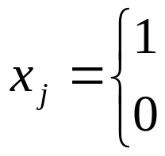
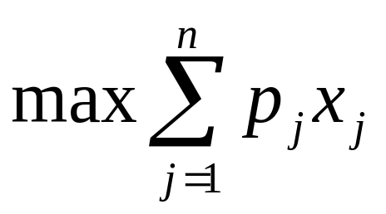
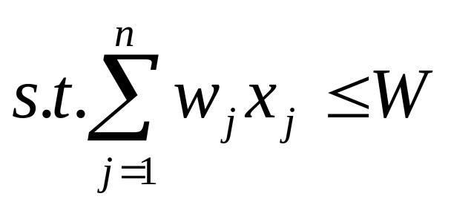
The Knapsack Problem
The profits, weights, and capacity are positive integers
Let x_{j} be binary variables given as follows:
The knapsack problem can be mathematically formulated as follow:
x_{j} = or 1, j = 1,2,….,n
if item j is selected
otherwise

Slide 5
The Knapsack Problem
This known as the 0-1 problem, which is a pure integer programming with single constraint and forms a very important class of integer programming
There are many variations of the knapsack problem, such as:
  the multiple-choice knapsack problem,
  the bounded knapsack problem, and
  the unbounded knapsack problem

Slide 6
The Knapsack Problem
Several researchers have solved the knapsack problem using genetic algorithms
The proposed genetic algorithms can be roughly classified into three classes:
  Binary representation approach
  Order representation approach
  Variable-length representation approach

Slide 7
Another GAs Applications
Fuzzy Flow-Shop Scheduling Problem
Job-Shop Scheduling Problems
Game-Playing Program
  Hexapawn
  Iterated Prisoner’s Dilemma
Image Processing & Pattern Recognition
Facility Layout Design Problems
Structural Optimization
Transportation Problems
Optimizations

